Slide 1


PROJECT
AUTOMATED IRRIGATION SYSTEM
Do Manh Thang
Phan Quyet Thang
Nguyen Vu Tu
MAY 18, 2023

Slide 2

Why automated irrigation system?
Using PID, the Automated Irrigation System minimizes water usage in agriculture.
By incorporating the PID algorithm, the system regulates irrigation based on soil moisture levels, ensuring optimal conditions for crop growth.
This system helps conserve water, improve crop health, and increase agricultural efficiency.

Slide 3
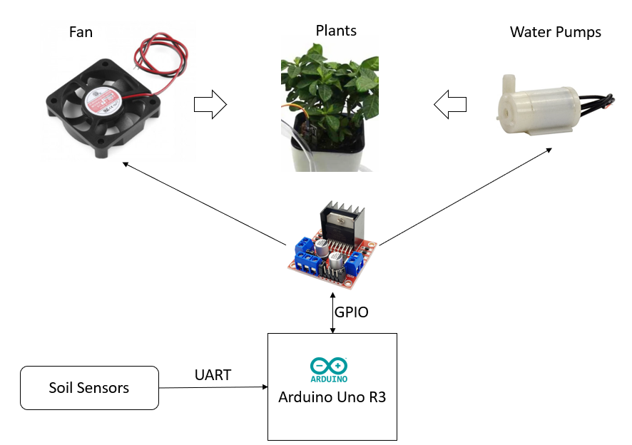

MOTIVATION
Monitor and compare soil moisture levels to predefined set values.
Design a system to regulate water irrigation and rapidly reduce soil moisture levels
Control environmental factors affecting moisture, ensuring minimal system deviation to environmental changes.

Slide 4
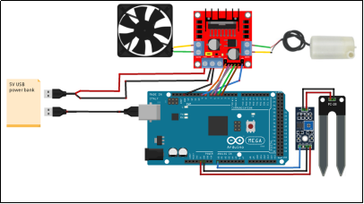
SYSTEM MODEL
Irrigation Control System Component
Microcontroller (Arduino Uno R3)
Soil Moisture Sensor (SMS-V1)
Fan
Pump

Slide 5

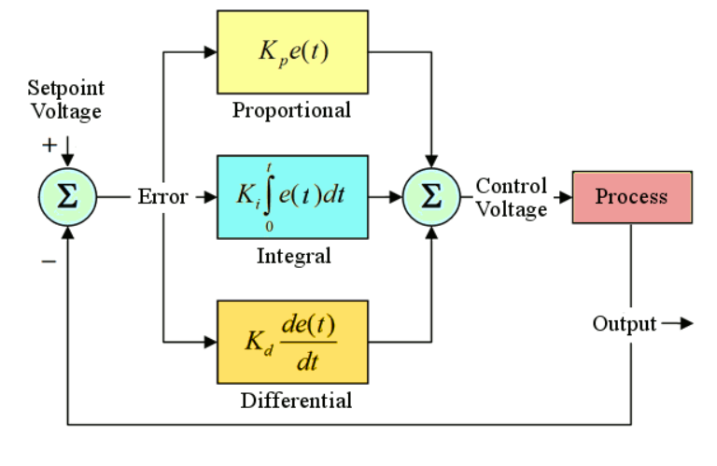
SYSTEM MODEL
System Operation
Sensing and Data Acquisition
PID Control Algorithm
Actuation (Motor Speed Adjustment)

Slide 6

LIMITATION
Plant-specific moisture requirements
Calibration and maintenance of soil moisture sensors
Power source considerations
Grid integration

Slide 7

SOLUTION AND FUTURE WORK
IoT Connectivity
Data Analytics and Machine Learning
Automated Decision-making
Smart Water Management
Mobile Applications and Alerts
Energy Optimization

Slide 8

CONCLUSION
Efficiently manage water resources for plant cultivation.
Customize system settings for specific crop requirements.
Embrace future advancements for enhanced performance.

